Slide 1

A mini Project Presentation On
Lifestyle Cart – E Commerce System

Slide 2

http://lifestylecart.ml/

Slide 3

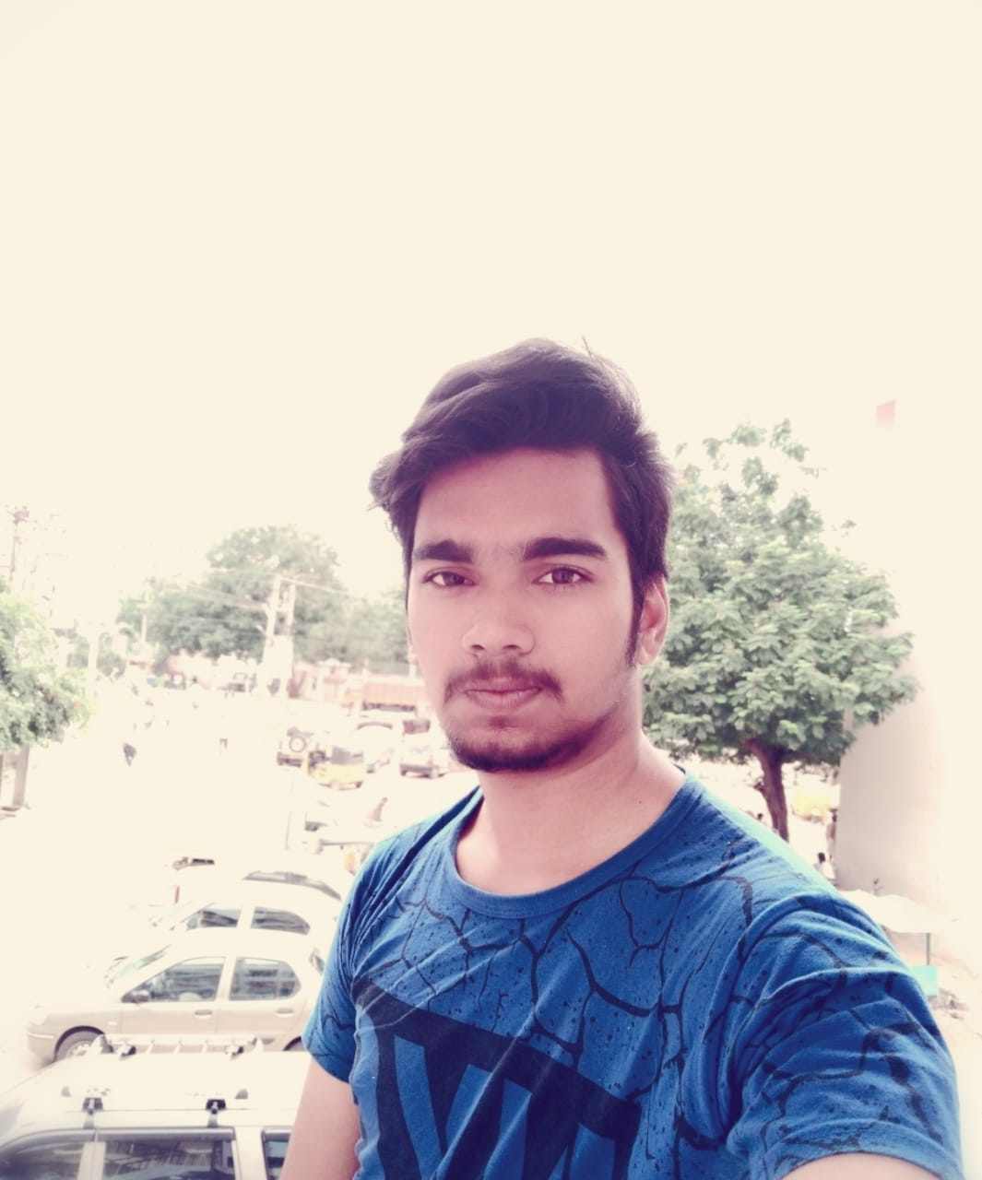
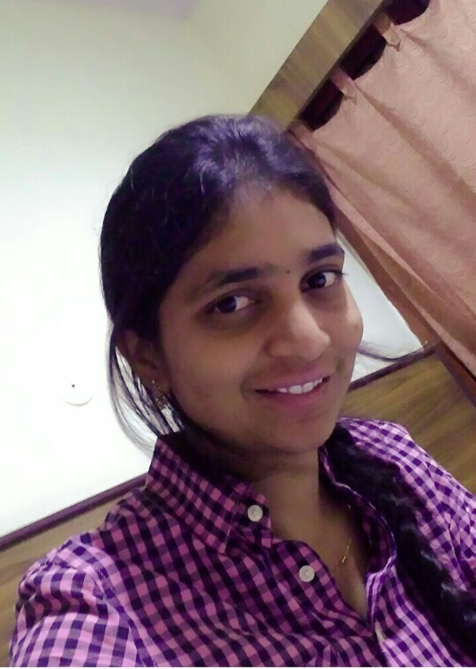
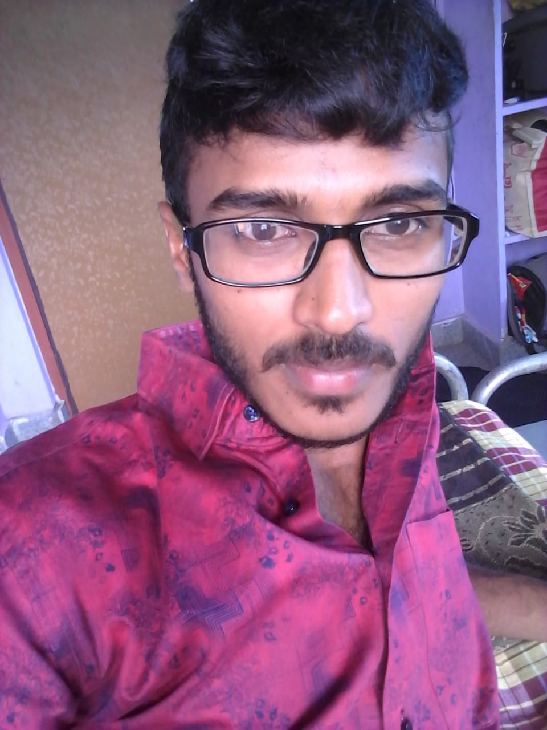
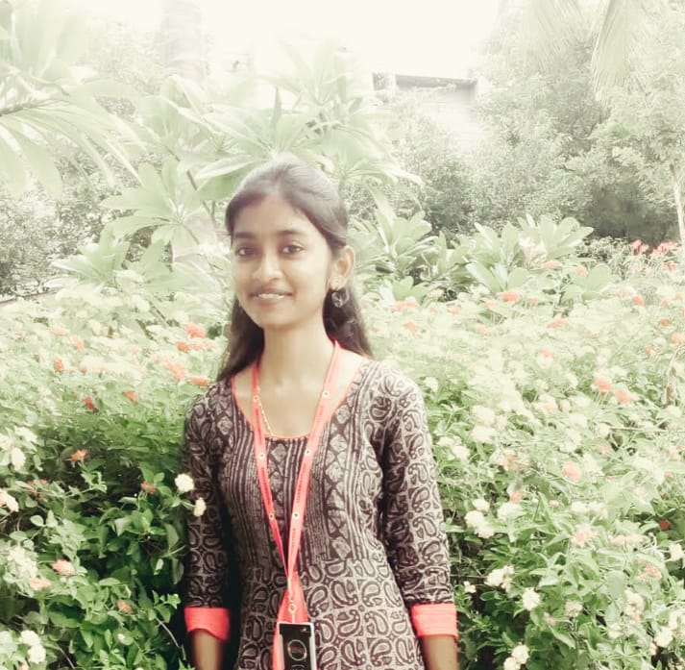

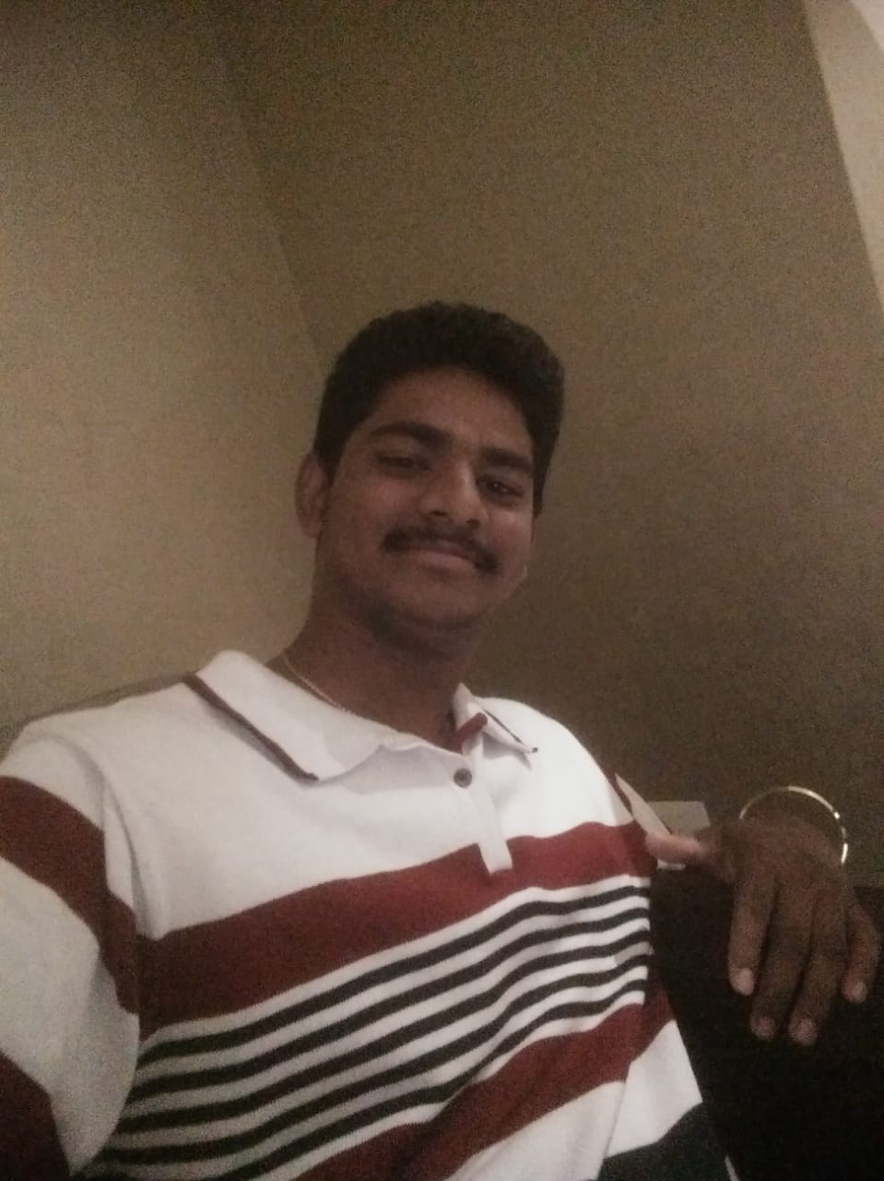
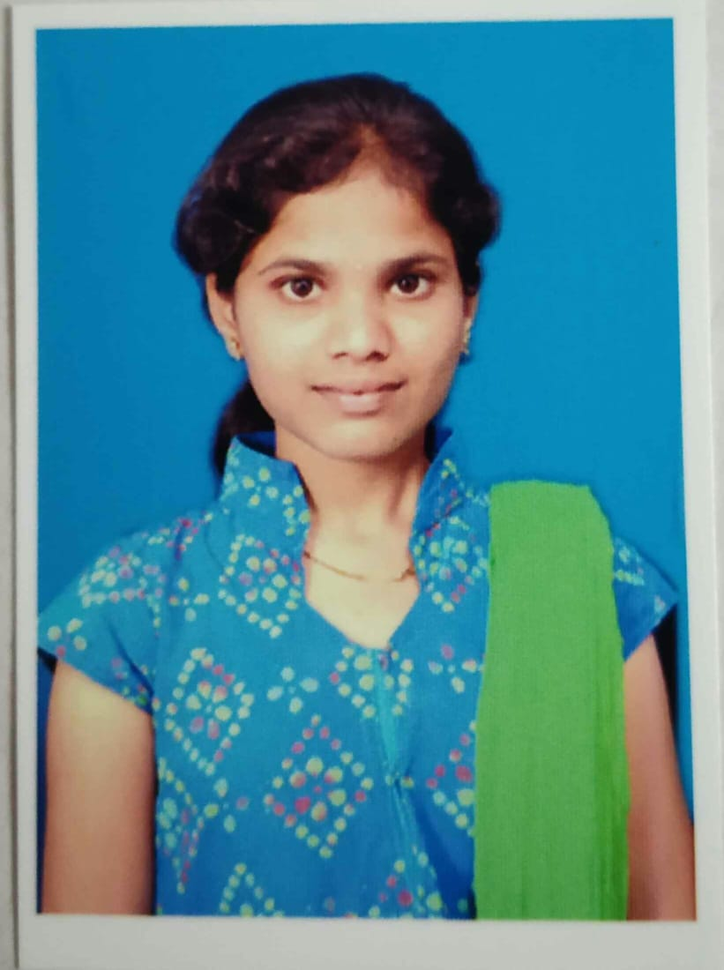

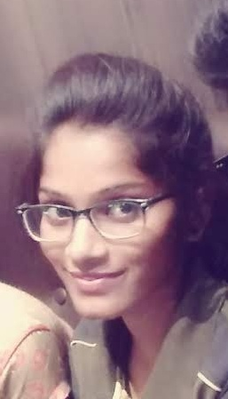
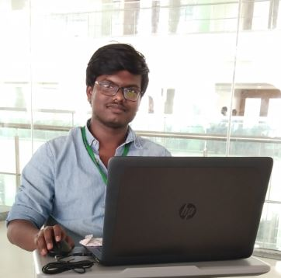
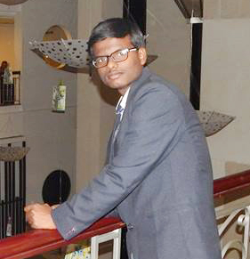
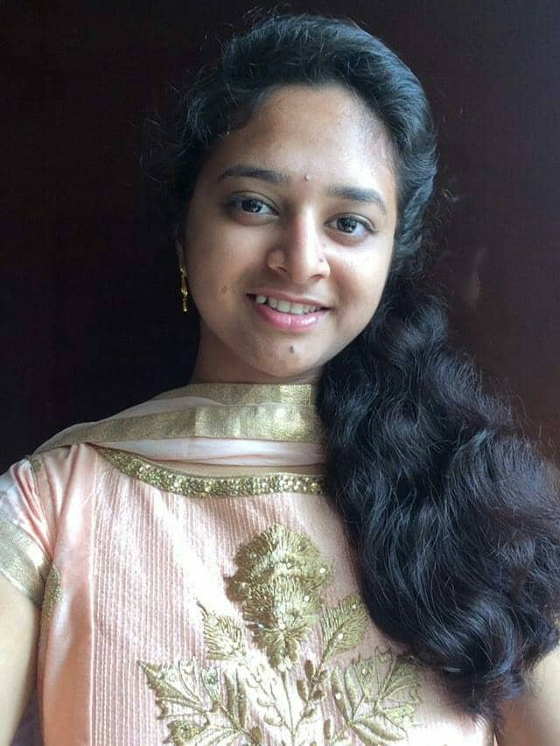
THE CREW
TEJASREE
DESIGNER
JAGADISH
DEVELOPER
DHARANI
DEVELOPER
HARSHA
DEVELOPER
VARSHA
DEVELOPER
RAM PRASAD
DESIGNER
PRAVEENA
DEVELOPER
SRI SUSHMA
DESIGNER
HEAD
HARI KRISHNA
DESIGNER
MONU
DEVELOPER
VAMSI KRISHNA
DEVELOPER

Slide 4
index
Abstract 7
Introduction 8
Analysis 10
Design 14
Modules 18
Results 25
Conclusion 30
Future Enhancements 31
References 32

Slide 5
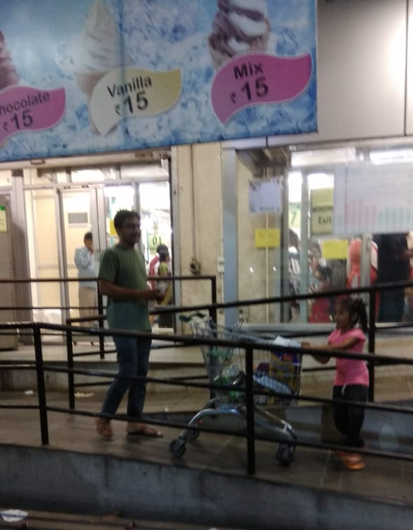
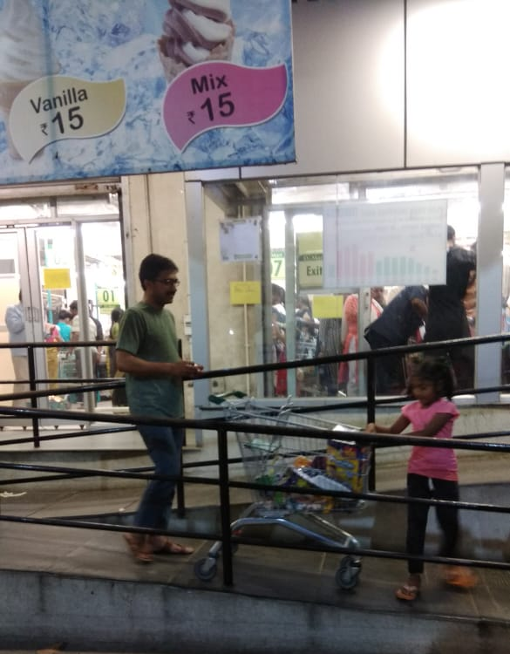
Normal shopping

Slide 7
abstract
This is a small scale project for Online shopping system. The basic idea is that customers can buy products using online. Also on the agenda is designing an online shopping site to manage the items in the shop and also help customers purchase them online without having to visit the shop physically. It is a web shopping cart that web enables the day-day sales functions. This website will be useful to anyone who wants to purchase items using internet.

Slide 8
introduction
The aim of this project is on the online shopping application it is developed using HTML5 Java script CSS and PHP.
The application is very useful where the buyer can directly buy the products from home via internet on mobile or system. The application reduces lot of work load for customer as well as owner.

Slide 9
introduction
Online shopping is a type of electronic commerce used for business-to-business:B2B; and business-to-consumer :B2C; transactions.
The term Web shop also refers to a place of business where web development, web hosting and other types of web related activities take place.

Slide 10
analysis
Study of the problem
Project Scope

Slide 11
Analysis – study of the problem
This Online shopping system involves with two types of users.
1. CUSTOMER
2. ADMINISTRATOR

Slide 12
Analysis – project scope
Functionality:
Since it stand alone application, one or more user may use it at a time.
Technology:
Front End: CSS java script HTML5 PHP
Back End: XAMPP
Database : MY SQL

Slide 13
Reliability:
The system is available during online time only.
Performance:
The performance depends on hardware specification.

Slide 14
design
Get an
order
Customer
Order details
Order an item
Store data
Receipt
Prepare the total amount and unique
code
Ask for bill
Admin
Confirmation

Slide 15
design

Slide 16
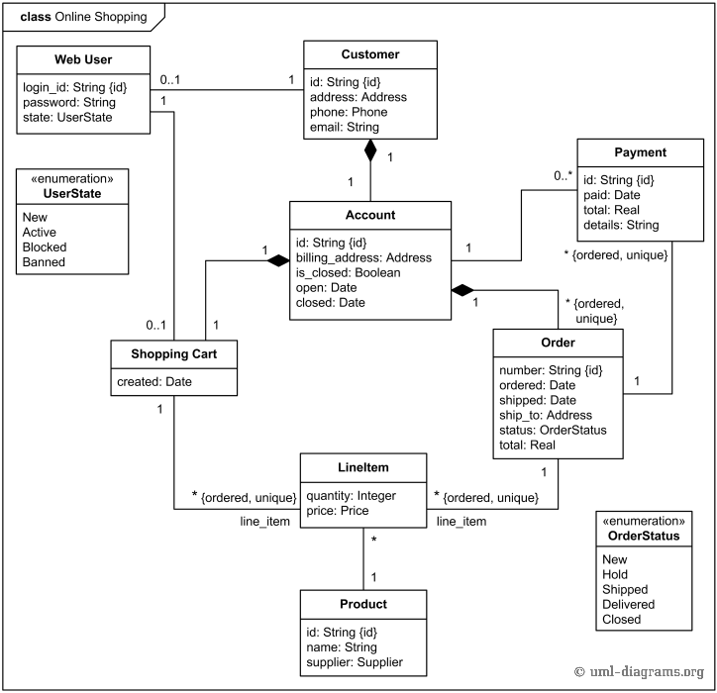
design

Slide 17
design
Login Activity:
Registration Activity Diagram:

Slide 18
MODULES
Register
Login
Item Selection
Payment Gateway

Slide 19
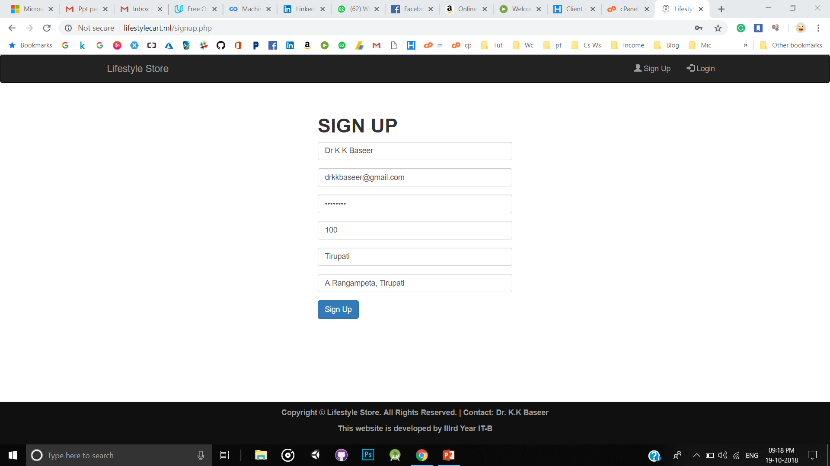
SCREENSHOTS OF lifestyle
Module 1 : Register

Slide 20
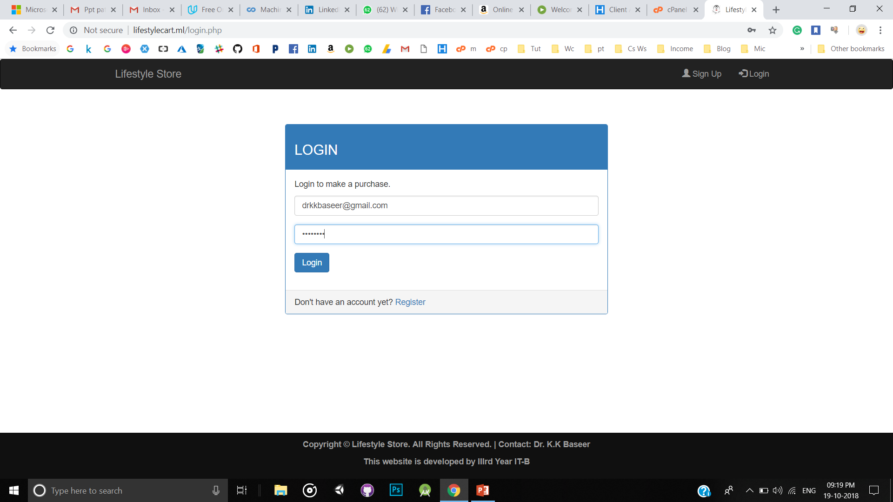
SCREENSHOTS OF lifestyle
Module 2 : Login

Slide 21
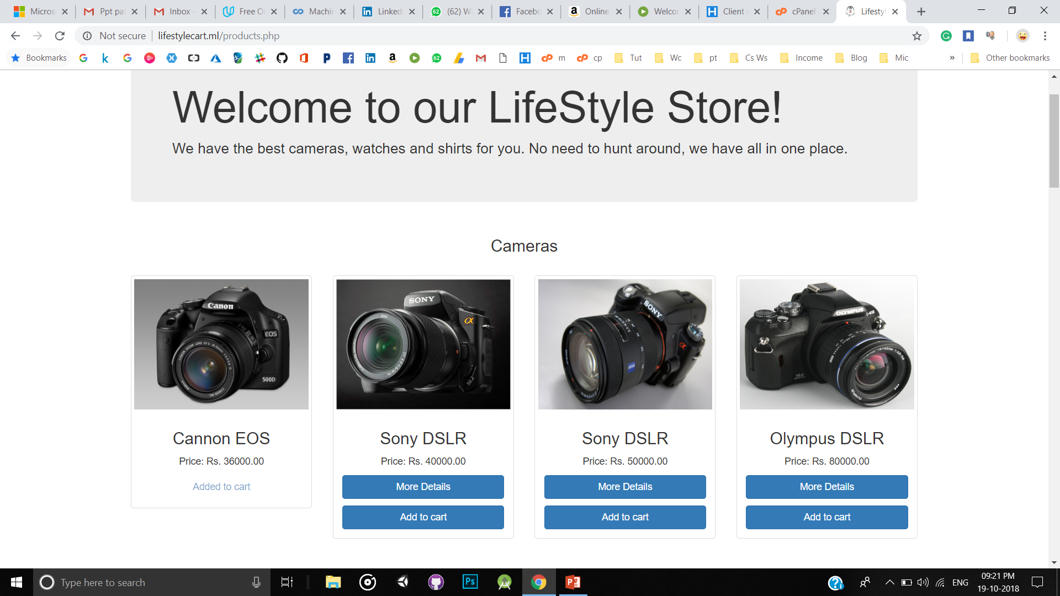
SCREENSHOTS OF lifestyle
Module 3 : Selecting Items

Slide 22
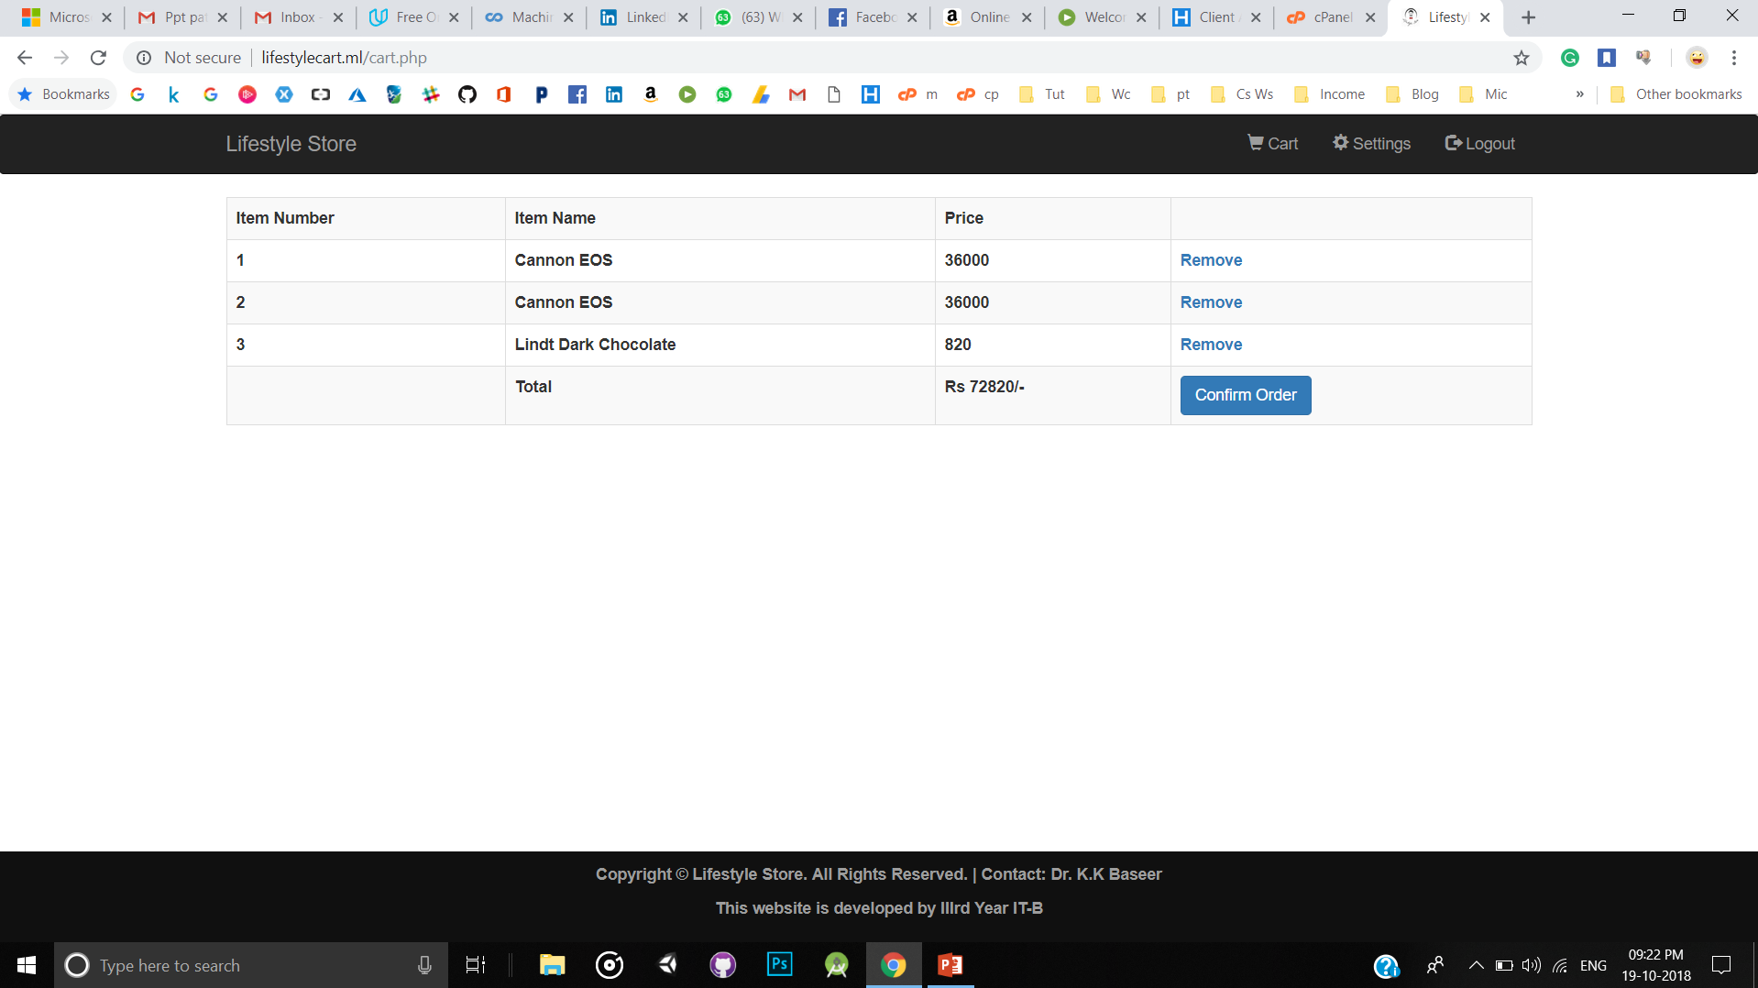
SCREENSHOTS OF lifestyle
Module 3 : Selecting Items

Slide 23
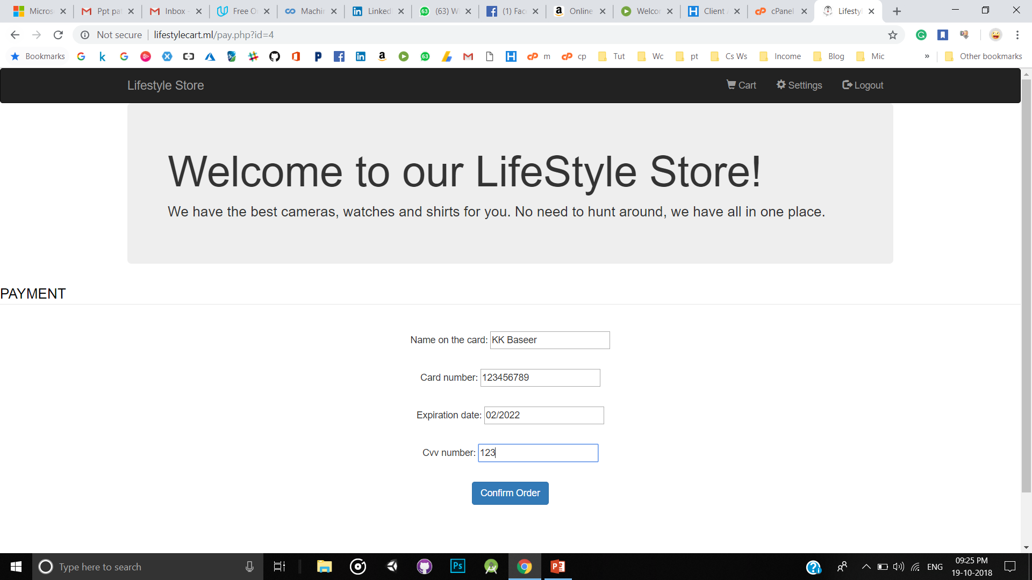
SCREENSHOTS OF lifestyle
Module 4 : Payment Gateway

Slide 24
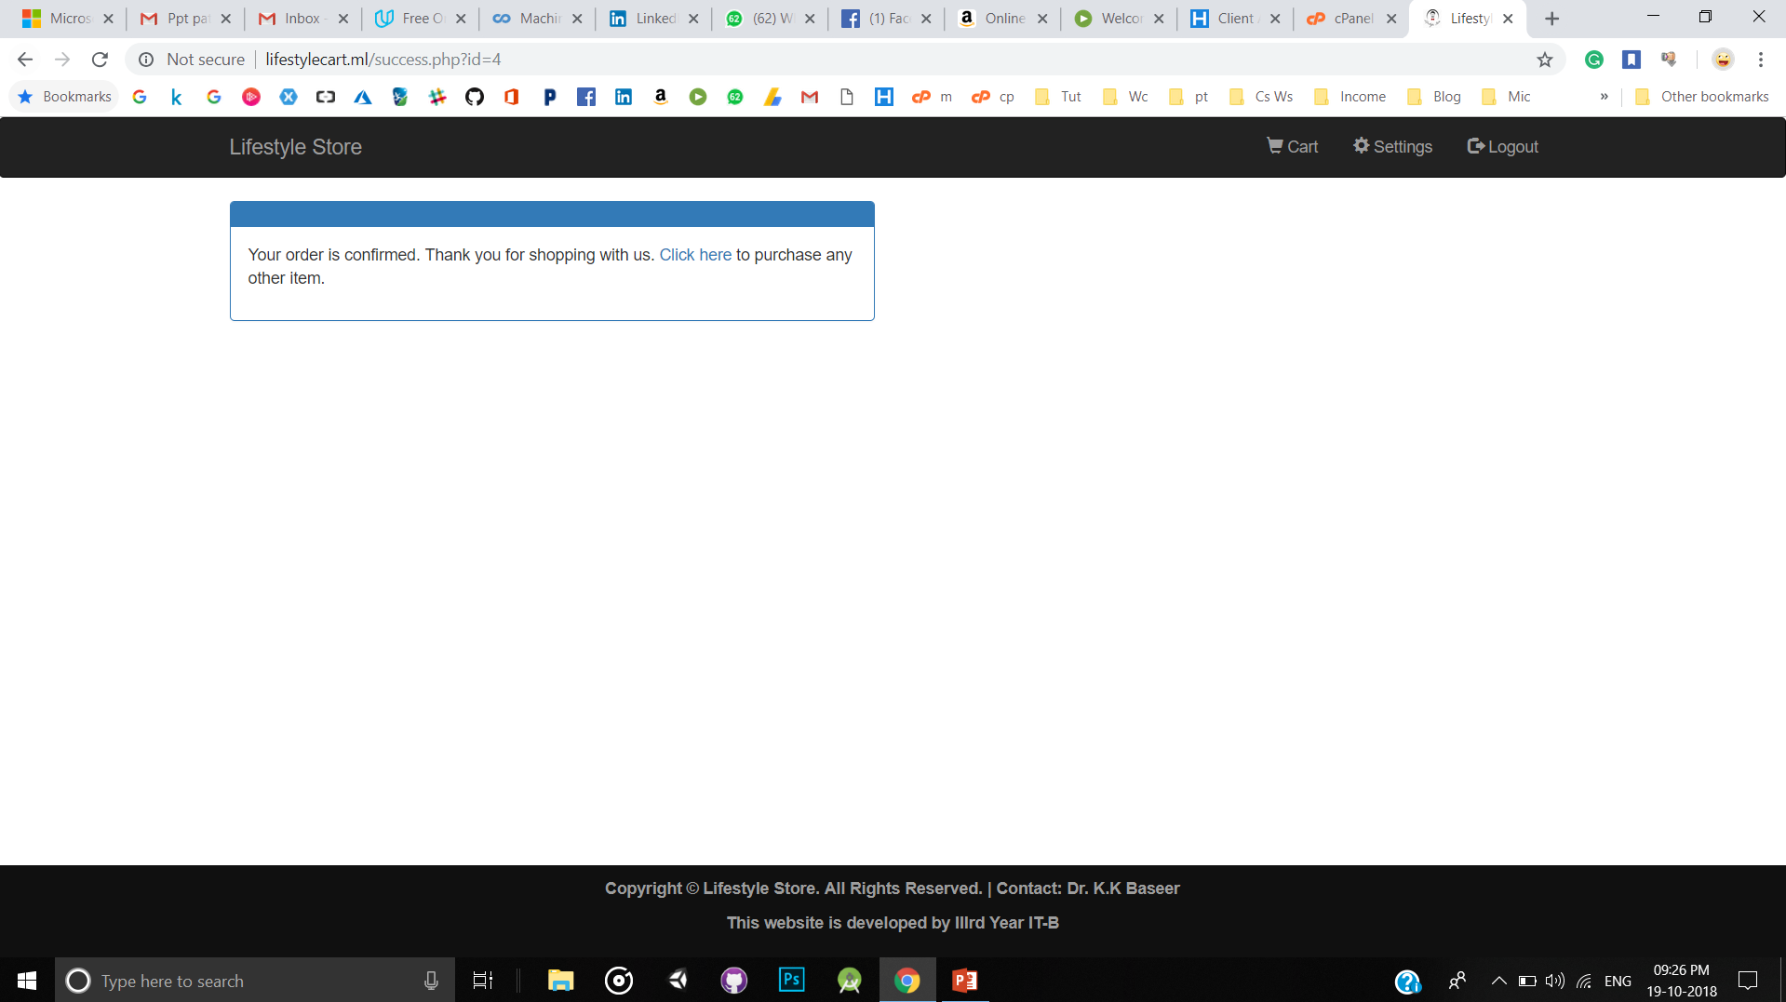
SCREENSHOTS OF lifestyle
Module 4 : Payment Gateway

Slide 25
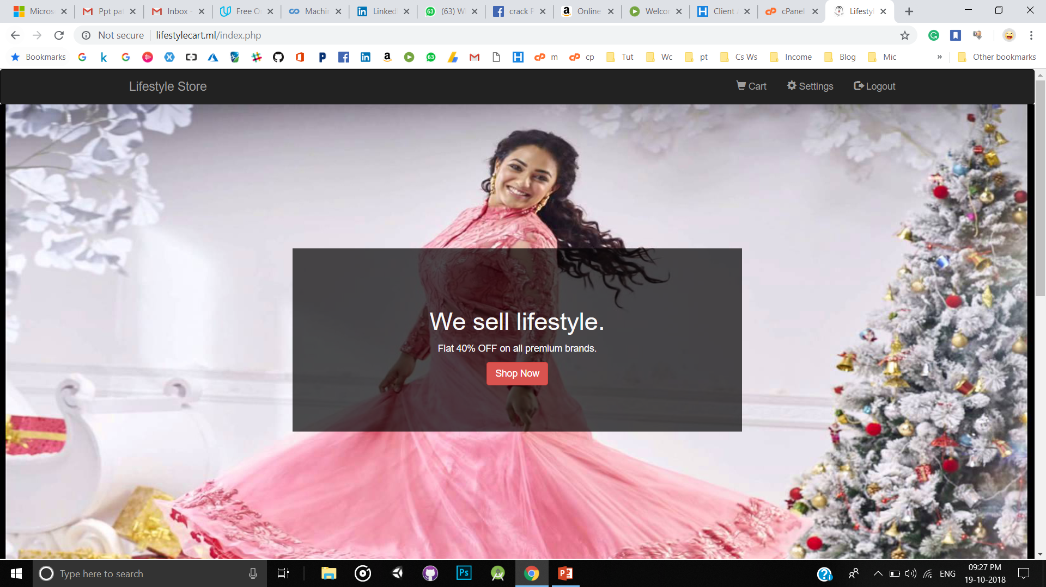
SCREENSHOTS OF lifestyle

Slide 26
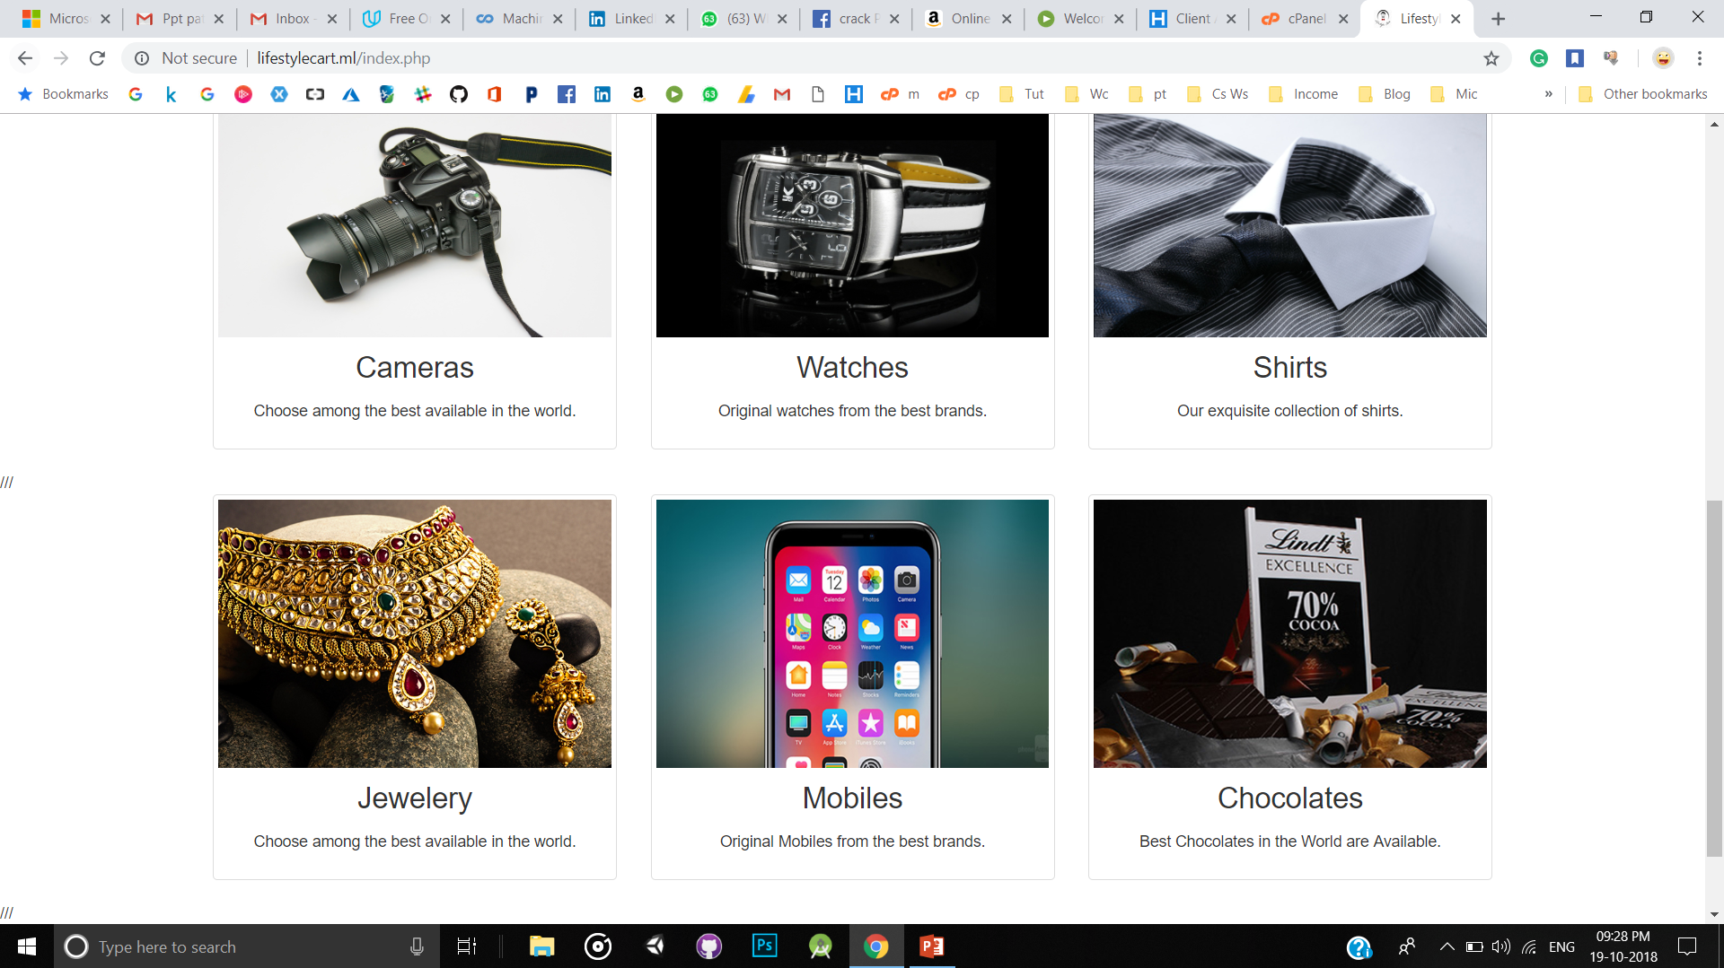
SCREENSHOTS OF lifestyle

Slide 27
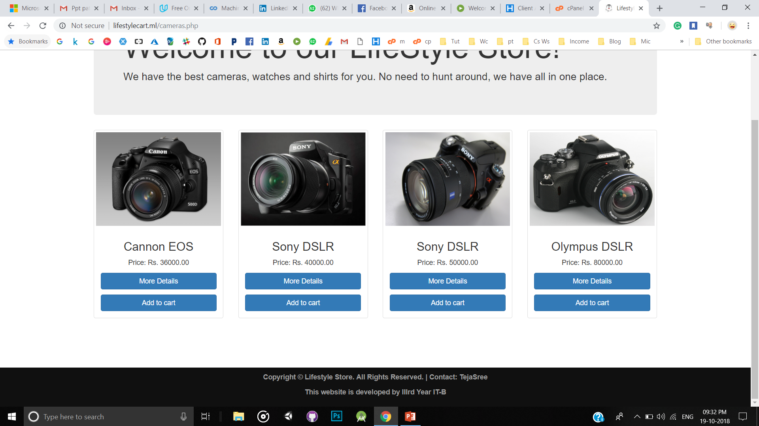
SCREENSHOTS OF lifestyle

Slide 28
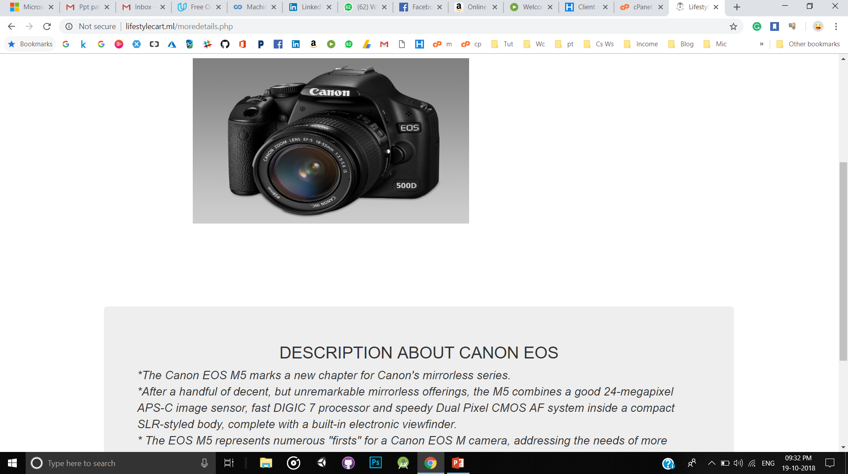
SCREENSHOTS OF LIFESTYLE

Slide 29
conclusion
Technology has made significant progress over the years to provide consumers a better online shopping experience and will continue to do so for years to come. With the rapid growth of products and brands, people have speculated that online shopping will overtake in-store shopping. However, the availability of online shopping has produced a more educated consumer that can shop around with relative ease without having to spend a large amount of time. At the end, it has been a win-win situation for both consumer and sellers.

Slide 30
FUTURE ENHANCEMENT
Most generic consumer to consumer e-commerce website, which covers almost all possible categories, with 2 level listing.
Maximize benefits and minimize the disadvantages of a common e-commerce website.
User friendly, Vendor friendly environment.

Slide 31
REFERENCES
[1]. Kogent Learning Solutions Inc, HTML 5 Black Book: Covers CSS3, JavaScript,XML, XHTML, AJAX, PHP and jQuery, Dreamtech Press, Second Edition, 2016.
[2]. W. Jason Gilmore, Beginning PHP and MySQL, APress, Fourth Edition, 2011.
[3]. Snig Bahumik, Bootstrap Essentials, PACKT Publishing, 2015. (e-book).
[4].https://www.tutorialspoint.com/web_development_tutorials.htmhttps://ww w.tut orialspoint.com/web_development_tutorials.html
[5]. https://www.w3schools.com/
[6]. https://www.lucidchart.com/blog/uml-diagram-templates
[7]. https://www.javatpoint.com/html-tutorial
[8]. https://developer.mozilla.org/en-US/docs/Web
[9]. UNIFIED MODELING LANGUAGE By Gradi Booch,Ivar Jacobson, James Rambaugh
[10]. https://mva.microsoft.com

Slide 32




